Slide 1

High Throughput Computing on RMACC Summit and Beyond
Andrew Monaghan
University of Colorado Boulder
https://github.com/ResearchComputing/Supercomputing_Spin_Up_Spring_2020
Adapted from slides and examples by Aaron Holt, CURC

Slide 2
Login and download course materials
If you have a Summit account:
ssh -X <identikey>@login.rc.colorado.edu
If you don’t have an account:
ssh –X user00NN@tlogin1.rc.colorado.edu
(for latter case, I will provide you with the “NN” and password)
…Once you are logged in, type the following three commands:
ssh scompile
cd /scratch/summit/$USER
git clone https://github.com/ResearchComputing/Supercomputing_Spin_Up_Spring_2020

Slide 3
What is HTC?
High throughput computing (HTC) recognizes that most scientists work on research timescales.
They value how many computing cycles they can get over a period of weeks-to-months rather than a period of hours-to-days.
Processor speed not a concern – volume is more important.
Processor type/homogeneity not important either.
Typical workflow may have hundreds-to-thousands of jobs.
Often comprised of many serial tasks that can be run independently.
Goal is to submit lots of jobs with minimal effort and oversight.
http://research.cs.wisc.edu/htcondor/htc.html

Slide 4
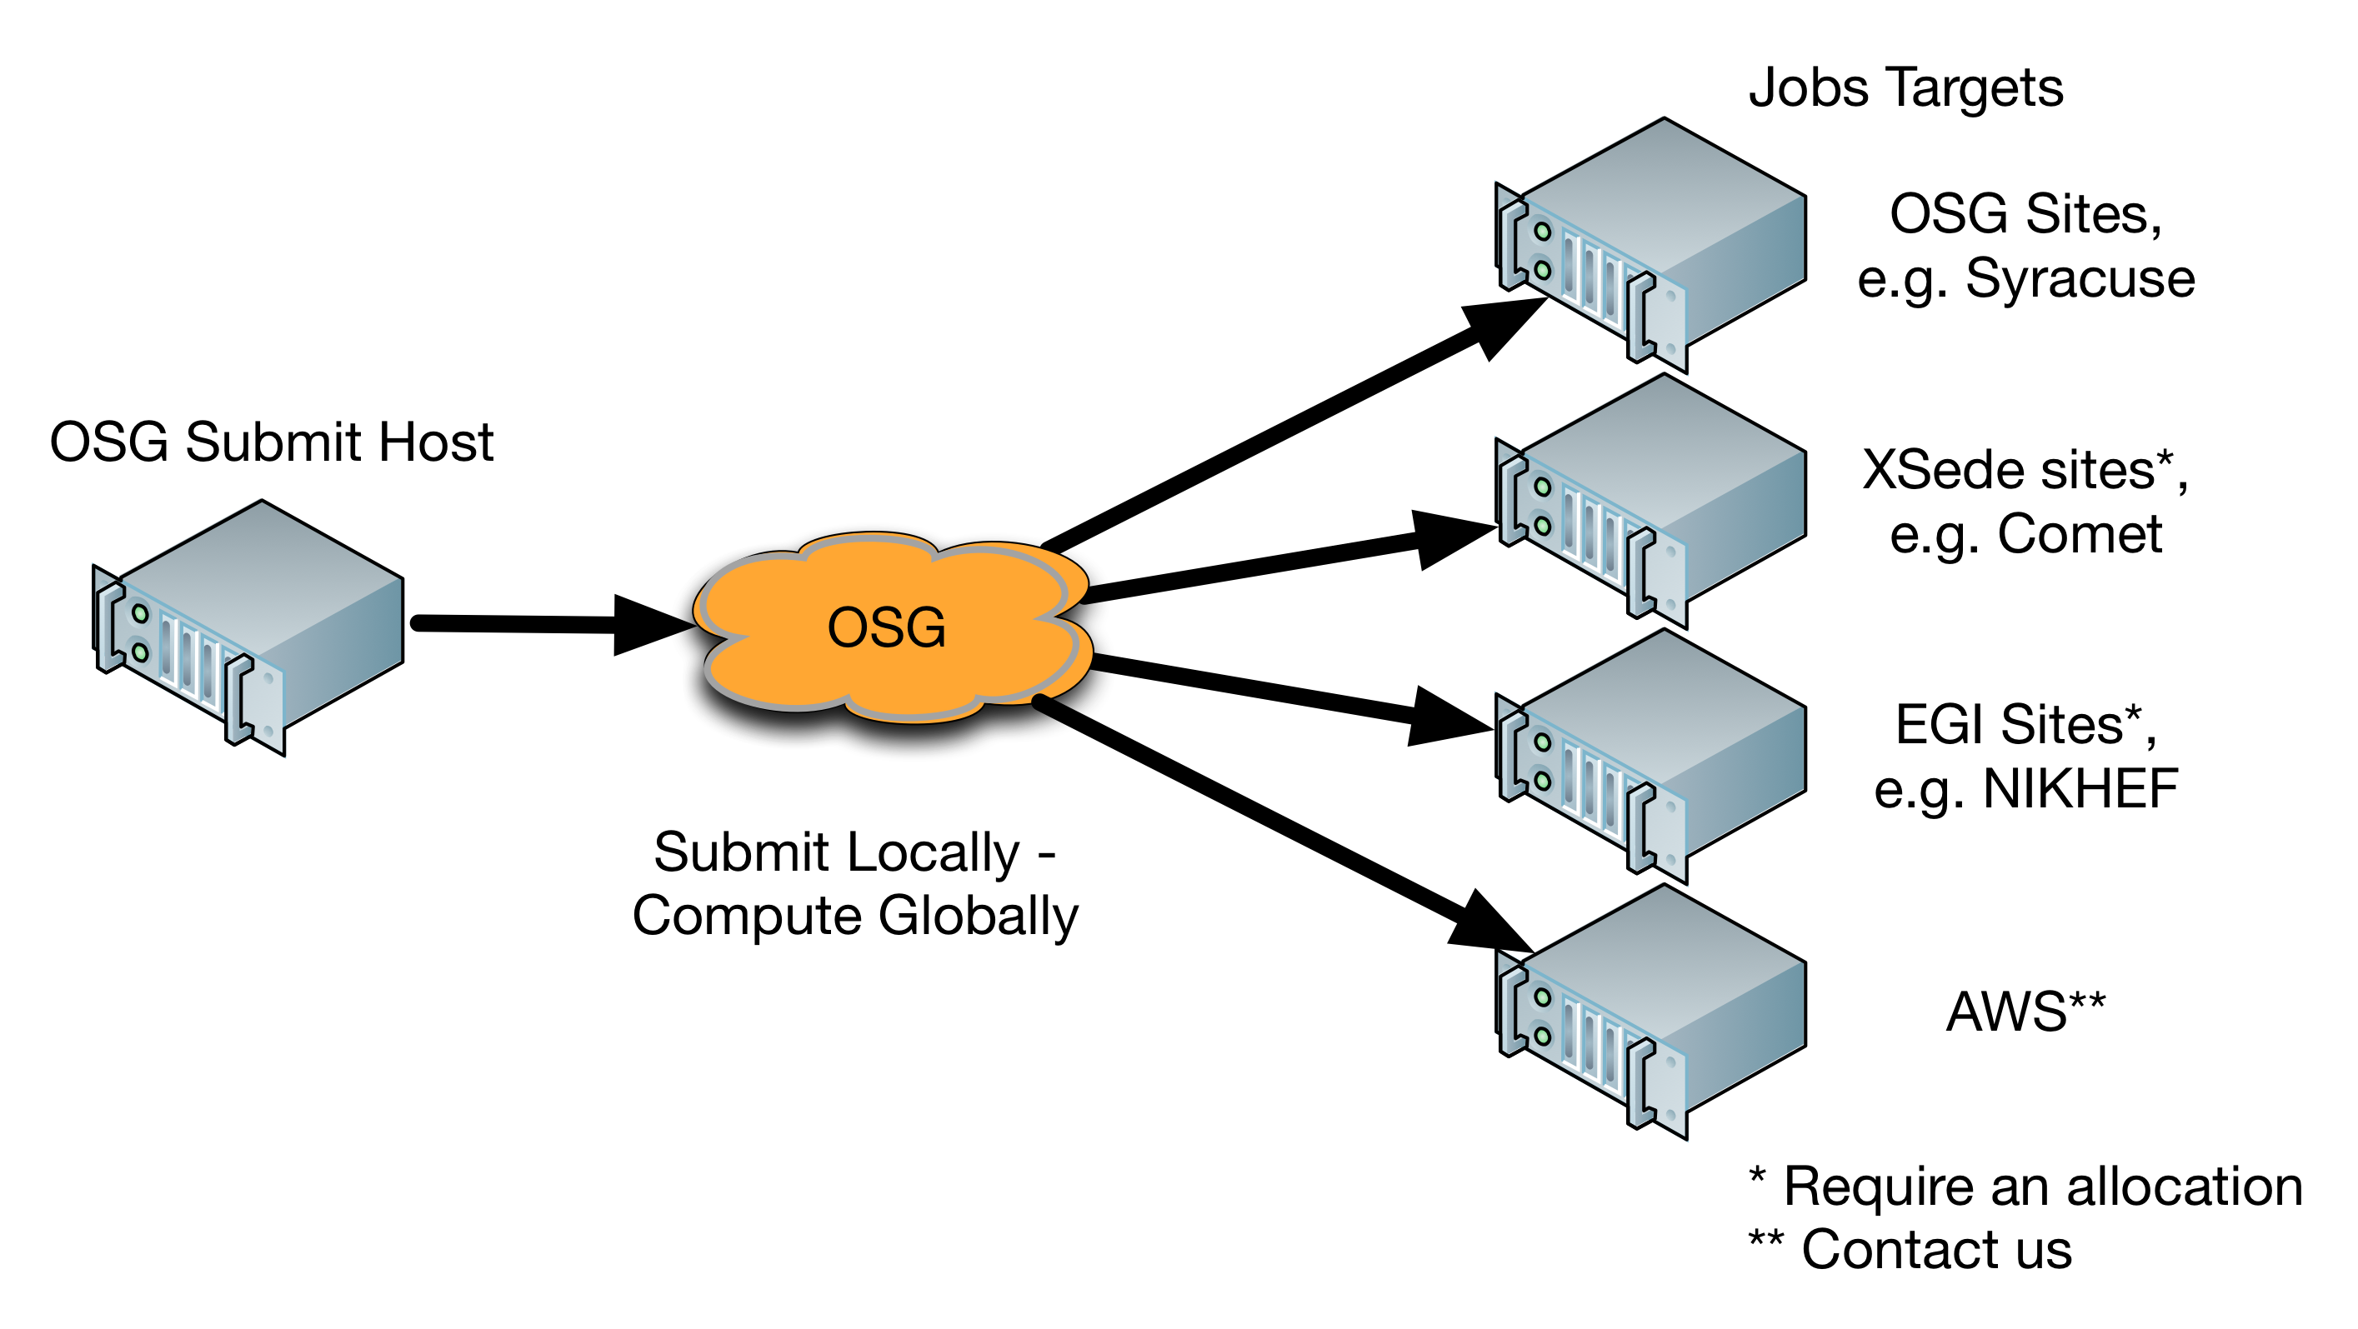
Example of ‘pure’ HTC resource
Open Science Grid (OSG)
NSF/DOE-funded service (free!)
Open to any U.S.-based researcher
125 institutions sharing spare computing cycles
~1 Billion core hours per year used
Can get started quickly. Options for dedicated allocation if needed.
https://osgconnect.net
https://swc-osg-workshop.github.io/OSG-UserTraining-JLab-2019/materials/AHM/01-IntroGrid.html

Slide 5
Can I do HTC on RMACC Summit?
Not quite at the scale of OSG.
But you can “wrap up” 100s-to-1000s of jobs and submit them all in one job script to any of the partitions/qos’s on Summit
Depending on the timescales of your workflow, this might also be called “many task computing” (MTC), which focuses on lots of tasks over shorter timescales.

Slide 6
How can I do HTC/MTC on Summit?
There are two primary ways, and we will cover both today:
Job arrays
Submit one Slurm job script that submits X jobs simultaneously
Great for lots of tasks that have heterogeneous run times
Each job usually runs a serial task but can be a multi-core task if needed
Jobs will run as cores become available
…works best for longer tasks (> 30 min)
Summit limits: Maximum array size of 1000; 100 jobs can run at once in ucb-general
GNU Parallel **or** CURC Load Balancer
Submit one Slurm job script that runs X tasks on N requested cores
All under one job that works through all X tasks in order, running N at a time (e.g., X=10,000 tasks on N=24 cores)
Great for lots of tasks that may have similar run times
…works best for shorter tasks (< 30 min)

Slide 7
Job Arrays
It is easy to adapt an existing job script to run as an array of jobs.
Add the following directive: #SBATCH --array=n-N
E.g., #SBATCH --array=1-200
You can also specify unevenly spaced arrays: #SBATCH –array=1,4,5,9,22
You can then just submit your job and it will run from n to N.
If your jobs depend on the array index, you can use the environment variable $SLURM_ARRAY_TASK_ID to invoke the present array number.
E.g., typing “python myscript.py file_${SLURM_ARRAY_TASK_ID}.csv” will run a python script over the array, each time processing a different file.

Slide 8
Example 1: job_array_ex1.sh
#!/bin/bash
#SBATCH --job-name=htcjob
#SBATCH --output=outfiles/htcjob.%A_%a.out
#SBATCH --partition=shas
#SBATCH --qos=normal
#SBATCH --time=00:00:05
#SBATCH --ntasks=1
#SBATCH --cpus-per-task=1
#SBATCH --array=1-12
# Run your program
echo "############################################"
echo "start array job ${SLURM_ARRAY_TASK_ID}"
echo "This job is performing $SLURM_NTASKS tasks"
echo "This job has reserved $SLURM_CPUS_PER_TASK cores for $SLURM_NTASKS tasks"
JOBMEM=$(echo "scale=2; $SLURM_CPUS_PER_TASK*$SLURM_MEM_PER_CPU/1000" | bc)
echo "Each task has $JOBMEM GB of memory allocated to it"

Slide 9
Example 1: job_array_ex1.sh
#!/bin/bash
#SBATCH --job-name=htcjob
#SBATCH --output=outfiles/htcjob.%A_%a.out
#SBATCH --partition=shas
#SBATCH --qos=normal
#SBATCH --time=00:00:05
#SBATCH --ntasks=1
#SBATCH --cpus-per-task=1
#SBATCH --array=1-12
# Run your program
echo "############################################"
echo "start array job ${SLURM_ARRAY_TASK_ID}"
echo "This job is performing $SLURM_NTASKS tasks"
echo "This job has reserved $SLURM_CPUS_PER_TASK cores for $SLURM_NTASKS tasks"
JOBMEM=$(echo "scale=2; $SLURM_CPUS_PER_TASK*$SLURM_MEM_PER_CPU/1000" | bc)
echo "Each task has $JOBMEM GB of memory allocated to it"
Let’s run the example:
sbatch job_array_ex1.sh --reservation=hpc

Slide 10
Example 2: job_array_ex2.sh
Example 2 is an extension of Example 1
We load python and R modules and then add lines to call python and R scripts
Both scripts read in array-ordered files from the “./infiles” directory as command-line arguments, and print the output to the “./outfiles” directory.
Examine job_array_ex2.sh
more job_array_ex2.sh
Run job_array_ex2.sh
sbatch job_array_ex2.sh --reservation=hpc

Slide 11
GNU Parallel
GNU parallel is a shell tool for executing tasks in parallel using one or more computers.
In it’s simplest form, GNU parallel is a parallel replacement of a do or for loop.
Options to specify how many tasks should run in parallel, display output in order, delay starts, limit resources and more!
Let’s get started with some command line examples. Start an interactive job:
sinteractive --ntasks=8 --reservation=hpc
ml gnu_parallel

Slide 12
GNU Parallel Useful Options
View what commands parallel will run without executing them:
seq 10 | parallel --dry-run echo {}
Limit number of tasks running at one time:
seq 10 | parallel -j 2 echo {}
Stagger start times for processes to avoid I/O overload:
seq 10 | parallel --delay 2.0 echo {}
See all the options:
man parallel

Slide 13
Let’s try working with files
Let’s run our python script on all of the input files in ./infiles:
find infiles/*.txt | parallel python python_array_test.py {}
Or we can read the commands and arguments from a file
find infiles/*.txt | parallel --dry-run python python_array_test.py {} > commands.txt
parallel < commands.txt

Slide 14
Example: gnu_parallel_ex1.sh
Job script is similar to job scripts for job arrays except:
Does not have the #SBATCH --array=n-N flag
Requires loading the gnu_parallel module
You will likely increase --ntasks because you want to spread tasks across many cores
All standard output goes to a single *.out file (unless you redirect output)
This example does the same tasks as job_array_ex2.sh:
We load python and R modules call python and R scripts
Both scripts read in files from the “./infiles” directory as command-line arguments, and print the output to the “./outfiles” directory.
Examine job script
more gnu_parallel_ex1.sh
Run job script
sbatch gnu_parallel_ex1.sh --reservation=hpc

Slide 15
CURC Load Balancer
In-house tool for executing tasks in parallel using one or more RMACC Summit nodes.
Very simple to use:
Step 1: Create file that lists tasks you want to run
One task per line
If multiple commands per task can separate each command with semi-colin “;”
…or if each task is a complex list of commands, can create a bash script for each task
Step 2: load modules and execute using “mpirun lb commands.txt”
Let’s try an example…

Slide 16
Example: load_balance_ex1.sh
Job script is similar to job scripts for job arrays except:
Does not have the #SBATCH --array=n-N flag
Requires loading the intel, impi and loadbalance modules
You will likely increase --ntasks because you want to spread tasks across many cores
All standard output goes to a single *.out file (unless you redirect output)
This example does the same tasks as gnu_parallel_ex1.sh:
We load python and R modules call python and R scripts
Both scripts read in files from the “./infiles” directory as command-line arguments, and print the output to the “./outfiles” directory.
We will reuse the “commands.txt” file we created during the gnu parallel exercises.
Examine job script
more load_balance_ex1.sh
Run job script
sbatch load_balance_ex1.sh --reservation=hpc

Slide 17
Which HTC/MTC tool should I use?
 | Job Arrays | GNU Parallel | Load Balancer
Job length? | Best for tasks > 30 min | Best for tasks < 30 min | Best for tasks < 30 min
Where can I use? | RMACC Summit, other HPC resources | RMACC Summit or your laptop/desktop | RMACC Summit, other HPC resources
Max jobs in queue? | 1000 (per array) | No | No
Max cores per job? | None; works well one one or multiple nodes | None but works best on one node/machine | None; works well one one or multiple nodes
Max cores per task? | None | None but most commonly used for serial tasks | None but most commonly used for serial tasks
Does it reserve a controller core? | No | No | Yes
Other features? | Easy to adapt a "regular" job script to accommodate job arrays | Great for replacing/speeding up loops; Can pick up where you left off if job times out; commonly found on any HPC system | Works well for input files with heterogeneous names ; easy to set up multi-node jobs

Slide 18
Other HTC/MTC resources
On Blanca: If you belong to a group with a Blanca node, this is a fantastic place to do HTC/MTC!
On OSG (if you grow beyond Summit)
https://opensciencegrid.org/about/introduction/
(Need help getting started on OSG? Contact me)

Slide 19
The end
We’d love your feedback: http://tinyurl.com/curc-survey18
CURC Load Balancer documentation
https://curc.readthedocs.io/en/latest/software/loadbalancer.html
GNU Parallel documentation
https://curc.readthedocs.io/en/latest/software/GNUParallel.html
https://www.gnu.org/software/parallel/parallel_tutorial.html
Slurm job arrays
https://slurm.schedmd.com/job_array.html
I would be happy to help you get started with HTC/MTC on Summit or OSG
andrew.monaghan@colorado.edu

